Slide 1

POSEFIX

Slide 2
POSEFIX

Slide 3
POSEFIX

Slide 4
AGENDA
Introduction / Problem
Solution / Business Idea
Technology
Implementation / Team
Competition
Marketing
Timeline
Business Model and Numbers

Slide 5
S
STRENGTHS:
User Experience: intuitive and user-friendly feedback as frame in traffic light scheme
Technology Stack: Advanced and secure technology
Strategic Partnerships: with tech companies, platforms or health organizations
Compliance with Privacy Laws: Adherence to GDPR, CCPA, etc.
Trust and Transparency: Open communication about data privacy
Sophisticated Monitoring: tracking performance, user behavior, etc.

Slide 6
W
WEAKNESSES:
Lack of business experience
Limited resources: Budget constraints, small team, etc.
Scalability issues unknown: challenge to handle increased users or data
Technical issues unknown: bugs, slow performance...more testing to be done
Marketing strategy: Limited reach due to limited resources
Dependency on Third-Party Platforms: reliance on app stores
User Concerns about Privacy: skepticism towards ergonomic video monitoring

Slide 7
O
OPPORTUNITIES:
Technological advancements: Leveraging new lightweight models, better packages, etc.
Regulatory changes: Stricter workplace regulation laws or policies
Partnerships or alliances with health insurances
Integration Possibilities: Opportunities to integrate with other apps, platforms, or services
Innovative Privacy Solutions: Improving data privacy while maintaining functionality
New features and growing into other markets: Manual labor, physiotherapy and workout

Slide 8
T
THREATS:
Competitive Market: similar products or big tech companies integrating our product
Regulatory Challenges: EU AI Act could impose restrictions or require compliance measures
Changes in consumer preferences: Increasing skepticism towards AI, less remote work or cultural development towards less long-term health orientation
Economic Downturns: Which could impact funding or consumer spending
Public Perception and Trust Issues: Perceived (or real) privacy concerns

Slide 9
Polina’s slides

Slide 10
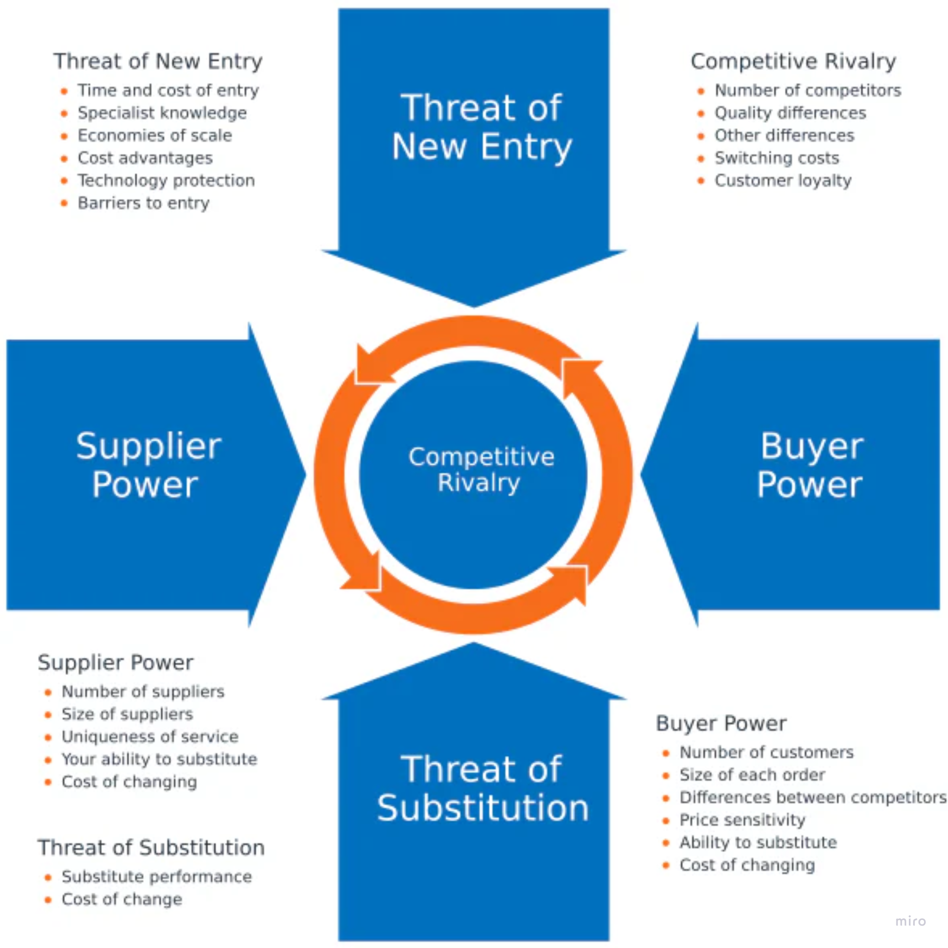
PORTER'S 5 FORCES

Slide 11
BUYER POWER
Number of customers: large
want smaller prices
Customers: elastic demand, not many alternatives, no switching costs
Businesses: elastic demand, not many alternatives, no switching costs
As the app operates on a subscription basis, users can easily switch to competitors if they are dissatisfied
Medium threat

Slide 12
SUPPLIER POWER
Software suppliers: not that many suppliers, differentiation, very stable, no switching costs
Low threat

Slide 13
COMPETITIVE RIVALRY
Number of competitors: 3
Multiple sensors systems with cameras: 0 companies, can be more accurate but less easier in establishment
Multiple sensors systems: 2 companies
Wearable sensors: accuracy depends on amount of sensors, not all people want to wear something on them
Solution with cameras: 1, similar to our solution
no switching costs
existing but not mature market
brand image plays the role
Product differentiation - medium
Medium threat

Slide 14
THREAT OF NEW ENTRY
Modest profitability, slow growth
expertise in sensor technology, machine learning, and biomechanics
technology protection
need prove and advertisement
need medical approval
brand identity is important
large capital requirements
economics of scale
Moderate
threat

Slide 15
THREAT OF SUBSTITUTION
Multiple sensors systems: it's not easy to establish all equipment, medium threat
Traditional Solutions: Traditional methods for improving posture, such as ergonomic chairs or physical therapy, pose a moderate threat.
-Other Health and Wellness Apps: Apps addressing general health and fitness may be substitutes, but the specific focus on posture control can mitigate this threat.
Low
threat

Slide 16
Mod
Low
Med
Med
Low

Slide 17
MARKETING METHODS
Digital Marketing:
Social Media Marketing:
Instagram, Facebook, TikTok, Twitter. Content and Reels creation
Search Engine Optimization:
mobile and user-friendly website
compression of images to make loading of site quicker
use effective keywords like "smartphone posture monitoring", "sitting posture reminder"
Informative meta descriptions that include key benefits and a call-to-action: "Transform your posture with our app - real-time monitoring, personalized feedback, and a healthier you."
Content Marketing
Blog Posts:
useful information about posture and health, educational content
Video Content:
videos that translate the need of taking care about posture
Influencer Marketing
Collaboration with bloggers and other influencers. This can be both fitness bloggers or not fitness bloggers but with target audience

Slide 18
MARKETING METHODS
Email marketing
Emails for registered users as a reminder, ChatBot in Telegram for reminder and answering questions
Partnership and Collaborations
Collaboration with health, fitness or wellness brands, for example, Wellpass
App Store Optimization
Optimize app store listings with relevant keywords, compelling descriptions, and high-quality visuals
Free Trials and Promotions
Offer free trials
Community Engagement
Create online communities, forums, or social media groups where users can discuss posture-related topics, share experiences. This can be done inside the company or a family
Leverage User Reviews and Testimonials
Encourage satisfied users to leave positive reviews on app stores

Slide 19

4PS OF MARKETING
PRODUCT
Intangible product - app
Features: real-time posture monitoring, personalized feedback, posture reminder, user-friendly interface
Our USP (unique selling point)
“You don’t need to worry about your posture while focusing, we will evaluate and report on your posture for you!“
"We will help you to develop a habit.“
“Don’t interrupt your flow!”
Needs:
posture correction
constantly remember about posture
Marathons
Healthy posture "club"
Subscription
Family subscription
Business subscription models

Slide 20


4PS OF MARKETING
PLACE
The app will be available on our website, App store and Google Play
PRICE
Free trial period 7 days
Payment for subscription once in a month, six months, year
Show the value: If you take care about posture now, you don't have to pay for medicine in the future
Custom features for extra charge
Multiple people subscription: family subscription

Slide 21

4PS OF MARKETING
PROMOTION
Create Instagram, Facebook and TikTok, WeChat, LinkedIn profiles with content that will be constantly updated
Bloggers and influencers can promote the app for commission
Paid advertising channels, such as Google Ads, Facebook Ads
Family subscription that will have lower price per person than single-person subscription
Price for subscription for six or twelve months at once will be cheaper
Black Friday
Cooperation with health insurances, physiotherapists

Slide 22
CUSTOMER GROUPS ANALYSIS
Criteria | Segment 1 B | Segment 2 A | Segment 3 A | Segment 4 B | Segment 5 C | Segment 6 A
Occupation | Graduated | Graduated, Employed | Students, Graduated or apprenticeship | Apprenticeship, Students | not employed, not students | E-Sports, Gamers
Age | 50-65 | 30-50 | 25-40 | 20-30 | 20-65 | 15-50
Family status | Married, "Empty nest" | Married, with kids | singles, married, with kids | Single | Married, Single, with kids
Income | 60.000-200.000 | 60.000-100.000 | 30.000-80.000 | 10.000-50.000 |  | 0-200.000

